Slide 1
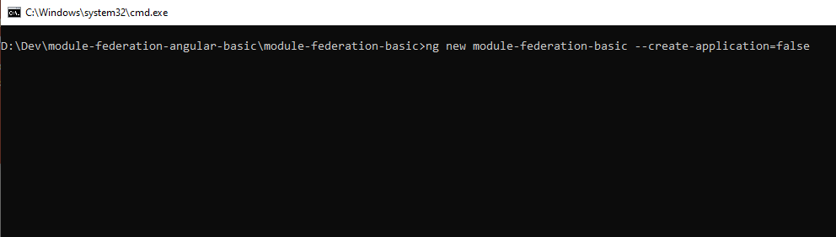
Create new angular workspace
ng new module-federation-basic --create-application=false

Slide 2
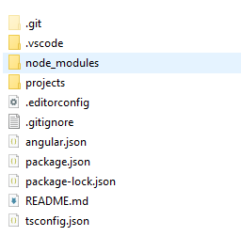
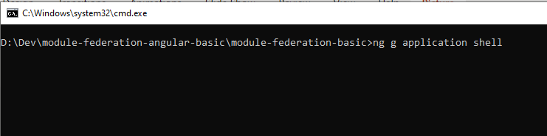
Create shell application
ng g application shell

Slide 3
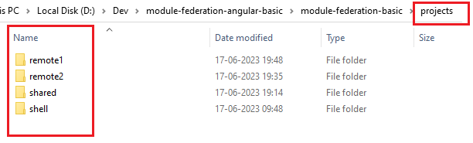
Create remote applications
ng g application remote1
ng g application remote2
Create a library application (optional)
ng g library shared

Slide 4
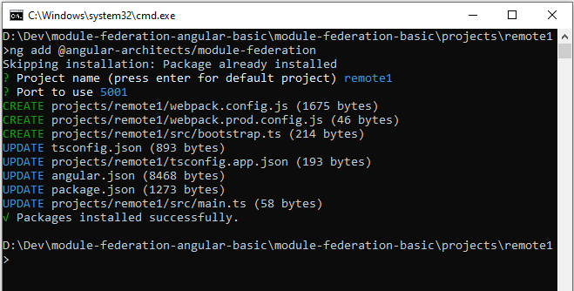
Add module-federation into project "remote1"
ng add @angular-architects/module-federation

Slide 5
Add module-federation into project "remote2" & "shell"
Move to project remote2 & shell perform the same action as last slide.

Slide 6
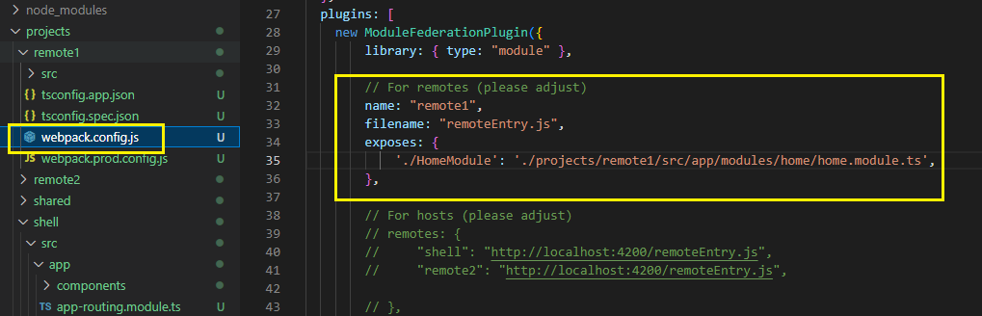
From "remote1" expose the AppModule
Open webpack.config.js
And add the module name and the path inside exposes object.
Do same for remote2.

Slide 7
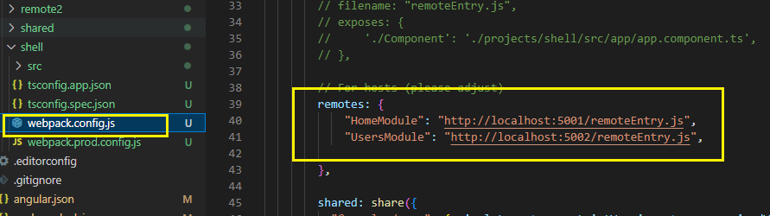
From "shell" define the remote paths
Open webpack.config.js
And add the paths for remote MFEs.

Slide 8
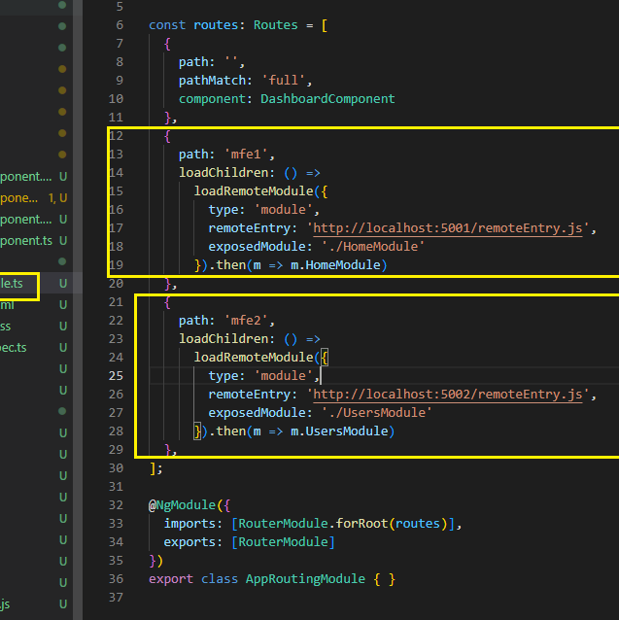
In "shell" configure routes to load modules
app-routing.module.ts
And add the paths

